Slide 1
Improve data-driven decisions.
Increase income by using accurate predictions.
Improve customer relationships by learning from user experiences.
Automate tasks that can be performed faster by AI.
Source: https://cprimestudios.com/blog/6-artificial-intelligence-use-cases-financial-services
PROCESS AUTOMATION
Artificial intelligence finance tools can offer massive support in process automation. There are a lot of tasks that are usually done manually by bank employees. For example, preparing documents or accessing information for clients.
Everything can be done in a few minutes or hours with AI automation. Another example of process automation with AI is the ability to verify personal ID. You often need to submit your ID and take a photo of yourself to be confirmed as a user. AI can check the match between an ID and a picture while examining that the ID was not used for fraud.
Source: https://cprimestudios.com/blog/6-artificial-intelligence-use-cases-financial-services

Slide 2
ustomer 360-degree insights – By leveraging advanced analytics, financial services organizations can know more about customer preferences, multichannel touchpoints, and buyer behavior factors. There is a high chance that the sales folks might perceive a different need, but the data speaks another consumer behavior. Understanding the customer in detail is critical for banking and financial services, unlike other industries.
Personalized customer experience – Experts perceive personalization as another critical aspect in BFSI to reduce churn and improve revenues. Offering the right product at the right time while also reaching out with personalized information after understanding every consumer detail is now the norm for sales teams in BFSI. A report from Forrester says that a single point improvement in financial services organizations’ CX score can improve revenues from $5-$123 mn.
Reduction in operational costs – Banks and financial services organizations are under constant pressure to maintain sleek profit margins and improve operations. Financial services firms can leverage predicting analytics, visualization, and AI to automate their workflows. Replacing paper-based forms with digital applications and using NLP technologies where ever necessary also helps in reducing manual efforts and errors.
Risk mitigation – The main challenge for BFSI firms is to analyze risks like credit, claims, and fraud. Though the practice is not new, banks, insurance companies, and investment bankers need to update their risk approach with the evolving technologies and exploding data from multi-channels. Financial services organizations can modernize their risk management practices more efficiently using predictive, behavioral, and advanced analytics.
Competitive advantage – Fintech organizations with technology as their core are already disrupting financial services. Financial services organizations now need to adopt technology faster than before. Processing a loan application can be done in minutes with AI and advanced analytics, thereby providing more scope for customers. Data analytics in banking will enable you to understand the unmet customer needs and help you unfold new consumer-centric business models.

Slide 3
Customer 360-degree insights – By leveraging advanced analytics, financial services organizations can know more about customer preferences, multichannel touchpoints, and buyer behavior factors. There is a high chance that the sales folks might perceive a different need, but the data speaks another consumer behavior. Understanding the customer in detail is critical for banking and financial services, unlike other industries.
Personalized customer experience – Experts perceive personalization as another critical aspect in BFSI to reduce churn and improve revenues. Offering the right product at the right time while also reaching out with personalized information after understanding every consumer detail is now the norm for sales teams in BFSI. A report from Forrester says that a single point improvement in financial services organizations’ CX score can improve revenues from $5-$123 mn.
Reduction in operational costs – Banks and financial services organizations are under constant pressure to maintain sleek profit margins and improve operations. Financial services firms can leverage predicting analytics, visualization, and AI to automate their workflows. Replacing paper-based forms with digital applications and using NLP technologies where ever necessary also helps in reducing manual efforts and errors.
Risk mitigation – The main challenge for BFSI firms is to analyze risks like credit, claims, and fraud. Though the practice is not new, banks, insurance companies, and investment bankers need to update their risk approach with the evolving technologies and exploding data from multi-channels. Financial services organizations can modernize their risk management practices more efficiently using predictive, behavioral, and advanced analytics.
Competitive advantage – Fintech organizations with technology as their core are already disrupting financial services. Financial services organizations now need to adopt technology faster than before. Processing a loan application can be done in minutes with AI and advanced analytics, thereby providing more scope for customers. Data analytics in banking will enable you to understand the unmet customer needs and help you unfold new consumer-centric business models.

Slide 4
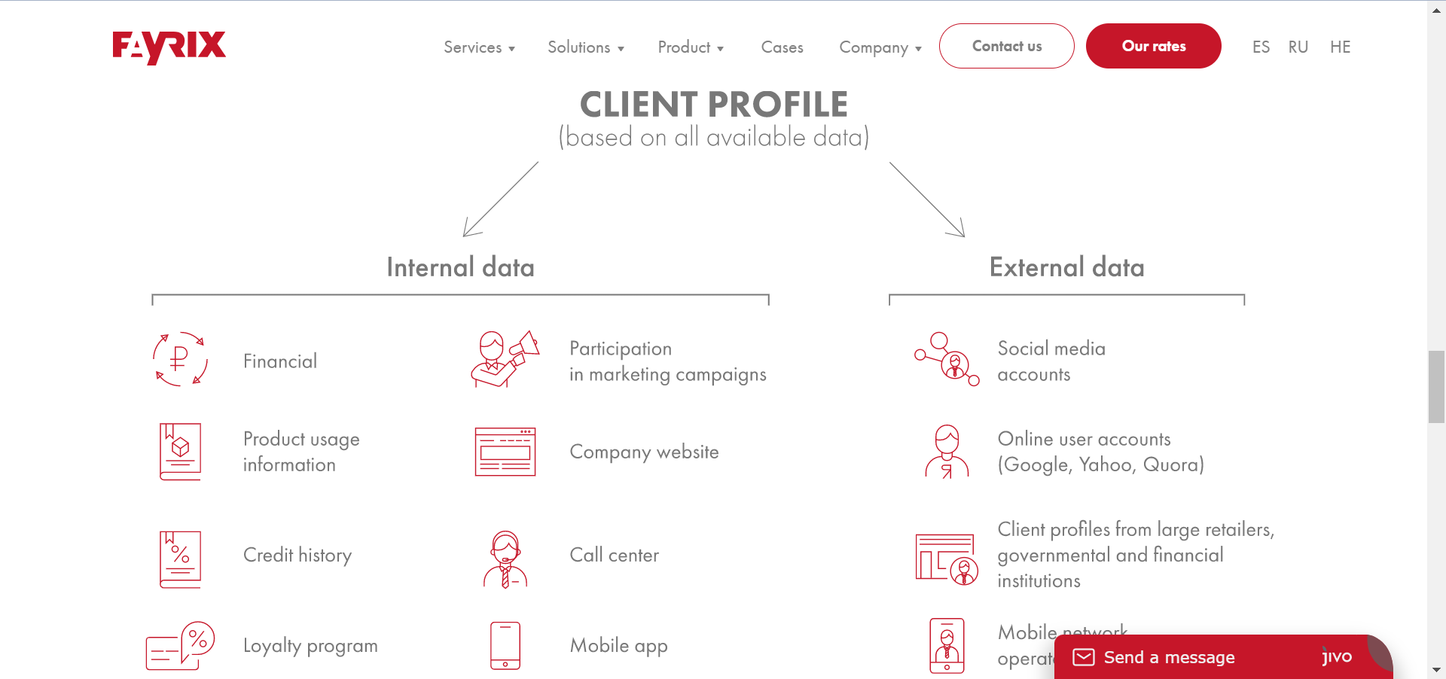
This can be accomplished by looking at real-time indicators that aren't considered in a typical credit score, such as whether the borrower spends their money on necessities or luxuries, their income level, employment opportunities, and potential to earn.

Slide 5
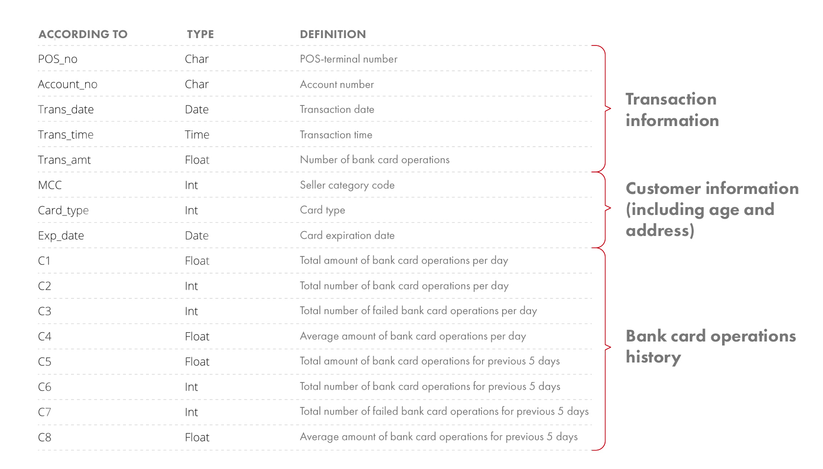

Slide 6
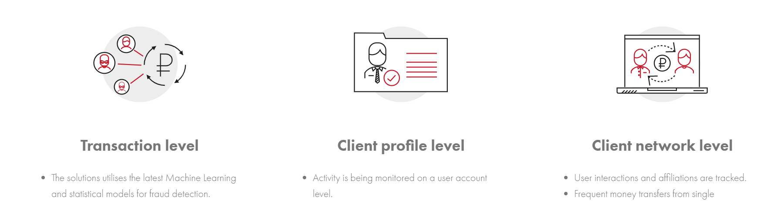

Slide 7
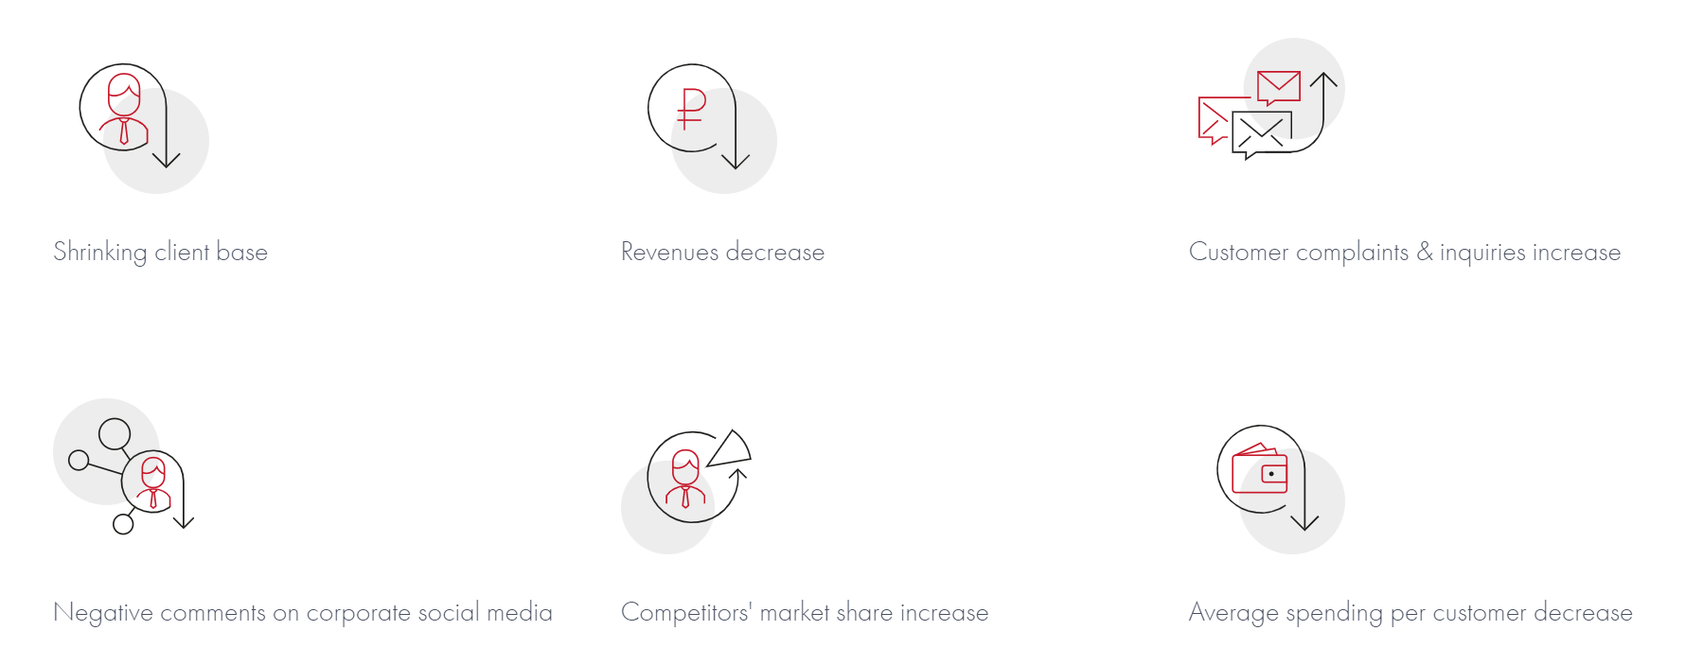

Slide 8
Credit risk modeling is not new in the banking industry. The traditional risk analytics models provided insights based on income sources, loan history, default rates, credit rating, demographics, etc. Many other factors need to be analyzed in conjunction with the standard data. Let us consider the case of consumer loans; different dynamics like social media profiles, utility bills, monthly spending, and savings give more profound insights into the default risk. Unstructured data plays a vital role in credit risk modeling too. AI-based text analysis and consumer persona provide deeper insights into the customers’ financial well-being.
Risk Analysis and Monitoring – Banks and financial services organizations that implement dynamic risk models with advanced analytics seem to be more resilient to significant external changes. Risk models differ between Banks and financial services – credit risk, fraud, and liquidity risk are the major ones for banks; claims risk and fraud for insurance and portfolio risk analysis for investment bankers. The common risk for most financial services firms is fraud detection is continuously evolving. Machine learning, AI, and big data now enable organizations to analyze many transactions, not just based on historical data. Social media profiles, behavioral analytics, predictive analytics, and advanced machine learning models are leveraged collectively for fraud detection.
Customer LifeTime Value – The trickiest one but looks like the most simple one to understand for anyone in the banking perspective. Customer lifetime value provides insights about the future revenue sources from the customer to focus marketing efforts and reduce churn. It is tough to estimate how customer behaviors change with time and the significant factors impacting their decisions. AI-powered advanced models recognize patterns more effectively in the data to provide behavioral insights that humans may not be able to identify.
Product Recommendation Engine – Are we talking about retail? No, product recommendation engines are evolving in banking too. Multiple comparison sites are now available for each financial services product – loan, insurance, mutual funds, credit cards, etc. Consumers can make informed choices, but cross-selling financial products at the right time cater to customer needs and enhances trust. Machine learning models process data in real-time from various content feeds to make the job easier for financial/investment analysts to offer personalized products and services.
Customer segmentation and personalized marketing – Understanding every aspect of the customer is critical for personalization. Customers are now bombarded with different financial products at the same time. How do you know if a customer is looking for an auto loan? Does the customer intend to purchase a home or an automobile? The place and timing of your marketing efforts matter in creating trust and showing intent to act on the marketing messages. You can also reduce awareness marketing efforts if you provide the knowledge at the right stage of the buyer journey.
AI-powered Virtual Assistants – Consider the case of insurance; a loss or damage may not happen multiple times. It is the single touchpoint to show the customers how you care for them and ease the processes. Customers now prefer efficient self-service options to in-person contacts to process their requests. AI-powered virtual assistants add value in answering all the information queries about products, services, and eligibility criteria in financial services. They are also evolving to validate certain criteria based on the rules updated with the machine learning models. It wouldn’t be a surprise to see that an AI-powered assistant does the insurance claims processing in minutes.

Slide 9
2. Manage customer data more efficiently
Financial institutions are responsible for managing vast amounts of customer data — transactions, mobile interactions and social media activity. This information can be categorised as “structured” or “unstructured” — the latter posing a real challenge when it comes to processing.
Employing data science within finance helps companies manage and store customers’ data far more efficiently. Firms can boost profits using AI-driven tools and technologies such as natural language processing (NLP), data mining and text analytics, while machine learning algorithms analyse data, identify valuable insights and suggest better business solutions.
5. Customer segmentation and targeted marketing
In order to effectively understand and reach customers, it is important to segment them into categories based on their likes, dislikes, needs, socio-economic status, etc. Financial services firms can then develop products and services designed especially for each segment. For a parallel in a retail environment, a business might split their clientele into higher and lower gross income segments. These would depend on the customers’ demographics and how much disposable income they are expected to have. The more disposable income they have, the more they are expected to spend in the store.

Slide 10
Machine learning enables the creation of algorithms that can learn from data, spot any unusual user behaviour, predict risks, and automatically notify financial companies of a threat. Data science helps banks recognise:
Fake insurance claims. With the help of machine learning algorithms, data provided by insurance agents, police, or clients can be analysed to spot inconsistencies more accurately than with manual checks.
Duplicate transactions and insurance claims. Duplicated invoices or claims aren’t always sinister, but machine learning algorithms can distinguish between an accidental click and a premeditated fraud attempt, thus preventing financial losses.
Account theft and suspicious transactions. Algorithms can analyse a user’s routine transactional data, then any suspicious activity can be flagged and verified by the card owner.

